Slide 1
Advanced functions

Slide 2
Overview
Variable hoisting
Function hoisting
Functions as data, benefits and use cases
Callbacks
IIFE - what it is and applications
Closure
Recursion

Slide 3
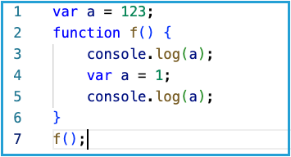
Variable hoisting
What will be the output of the following:
The first console.log will show undefined.
A local variable overwrites any global variable with the same name, called shadowing
At the time of the first console.log(), the variable a was not yet defined (hence the value undefined), but it still existed in the local space due to the special behavior called hoisting.

Slide 4
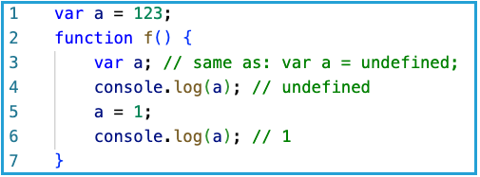
Variable hoisting
Only the declaration is hoisted, meaning only the presence of the variable is moved to the top.
It's as if the last function was written like this:
When program execution enters a new function, all the variables declared anywhere in the function are moved (or elevated, or hoisted) to the top of the function.

Slide 5
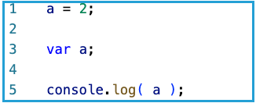
Variable hoisting
What will happen here?
The output will be 2, because the declaration is hoisted and row 1 is executed afterwards assigning the value of 2.
⚠ Keep in mind that declarations with let and const are not usable before their declaration. ⚠

Slide 6
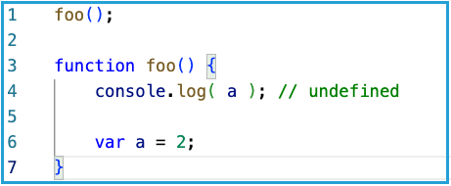
Functions hoisting
Only function declarations are hoisted, while function expressions will result in an error.
Not that hoisting is per scope. What that mean is that the declaration of the variable a will be “moved” to the top of the function, not the whole program.

Slide 7
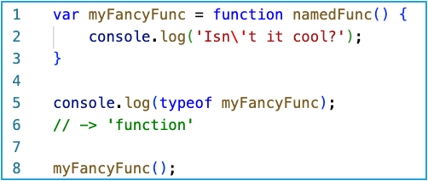
Functions as data in JS
Functions in JS are first class citizens, meaning whatever we can do with variables, we can do with functions also!
typeof operator returns ‘function’, meaning that functions in JS are just treated as other data

Slide 8
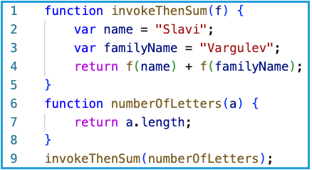
Storing functions in variables
Much of the language's flexibility and expressiveness comes from that fact:
We can store functions in variables
We can pass functions as arguments, which gives us ability to react differently (execute different functions) based on some logic

Slide 9
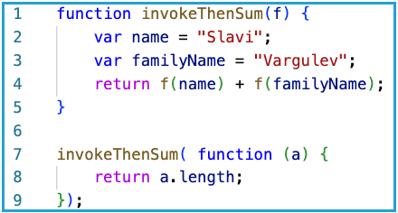
What is the benefit of functions as data?
When we pass function as an argument, we are defining a callback - This means that in a specific situation the main function will call back the function we provide it.
We can also use anonymous functions directly in the arguments

Slide 10
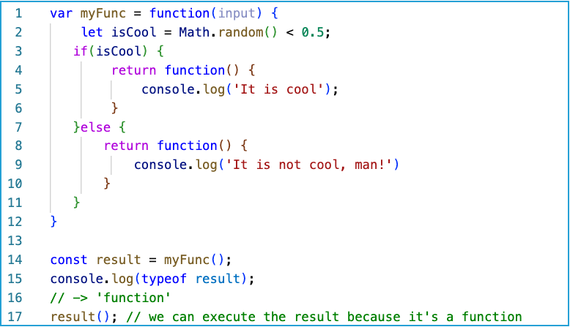
What is the benefit of functions as data?
We can also return functions as a result of the execution of another function

Slide 11
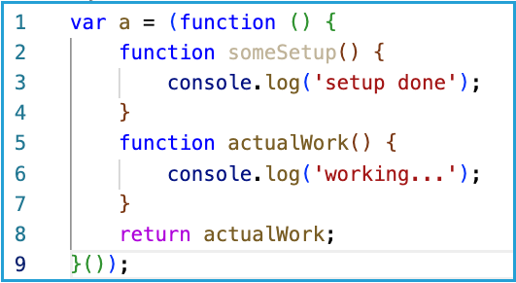
IIFE - Immediately invoked function expression
IIFE is invoked only once, so it is suitable for logic we only want to be executed once in our whole application
The inner function someSetup cannot be accessed from the outside
Another application of IIFE is creating an inner scope and not polluting the global one

Slide 12
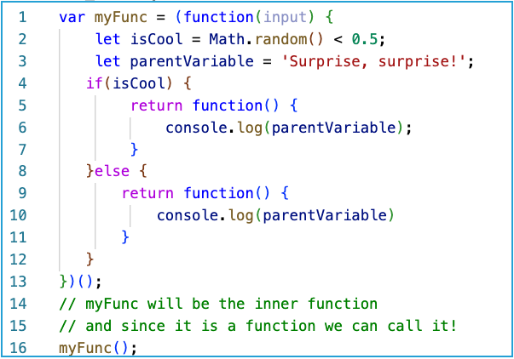
Closures
Closure is the ability of a function to reference variables from a parent function scope after the parent function execution has been completed.

Slide 13
Brace yourselves! Recursion is coming!

Slide 14
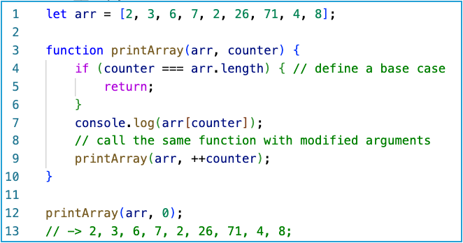
RECURSION
Recursion in programming is when a function calls itself inside of its body.

Slide 15
RECURSION
Recursion is used to solve problems by chopping them into smaller and smaller identical problems until a base case is reached. Proper recursion is defined by:
base case - the input for which we know the solution without the need of further recursive callings
recursive step - calling the same function with modified arguments that eventually reach the base case

Slide 16
RECURSION - MEMORY USAGE
Recursive operations are memory expensive. That is because we have separate stack-frame for every call of the function. In order to finish its execution the first/top level/ function must wait for all other levels to finish.
Like here, where the coins are picked up from the bottom and carried to the top and all the holes digged before wait till they can be filled again.

Slide 17
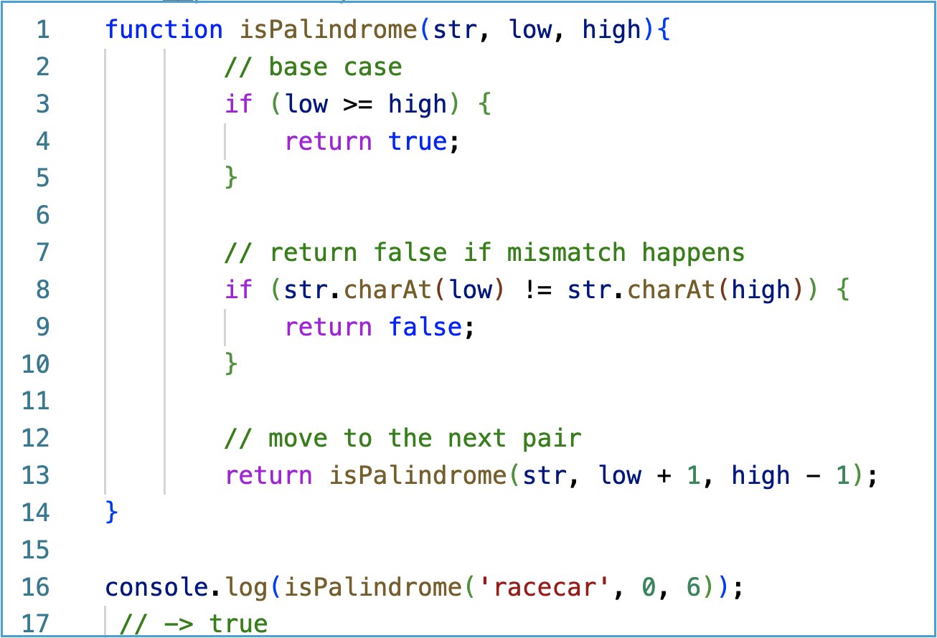
RECURSION - EXAMPLE

Slide 18
THE END!

